Slide 1

HR DATA ANALYSIS
SQL PROJECT WORK

Slide 2
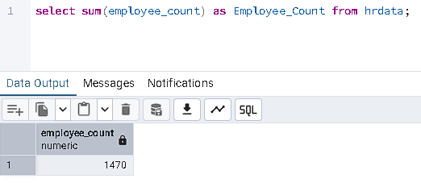
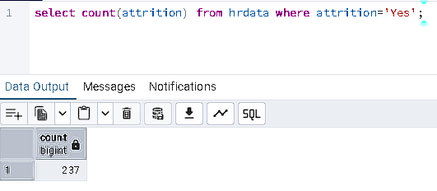

1. Employee Count:
2. Attrition Count:

Slide 3
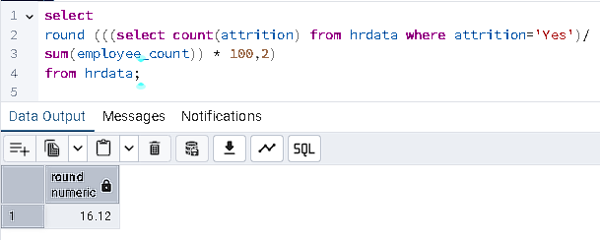
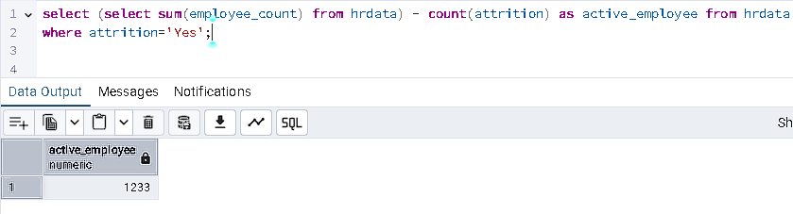
3. Attrition rate:
4.Active employee:

Slide 4
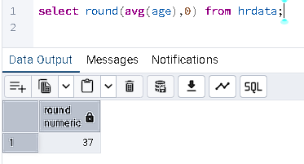
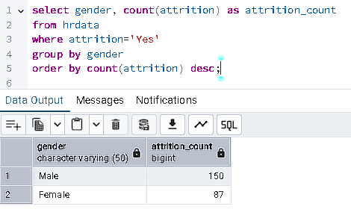
5. Average age:
5. Attrition by gender:

Slide 5
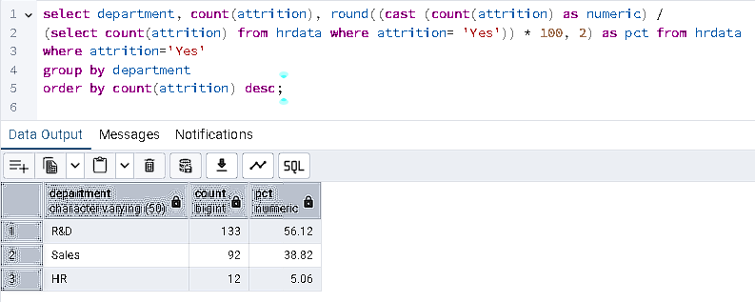
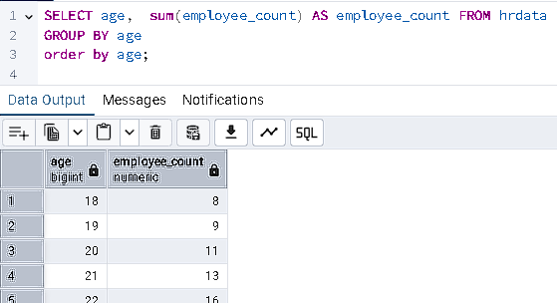
7. Department wise attrition:
8. No of employee by age group:

Slide 6
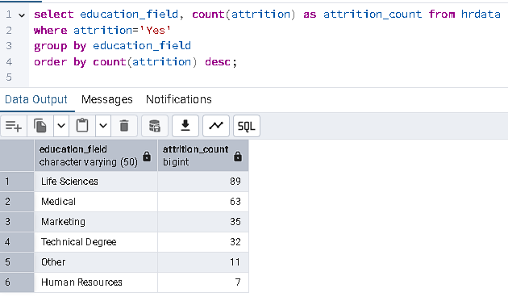
9. Education field wise Attrition:

Slide 7
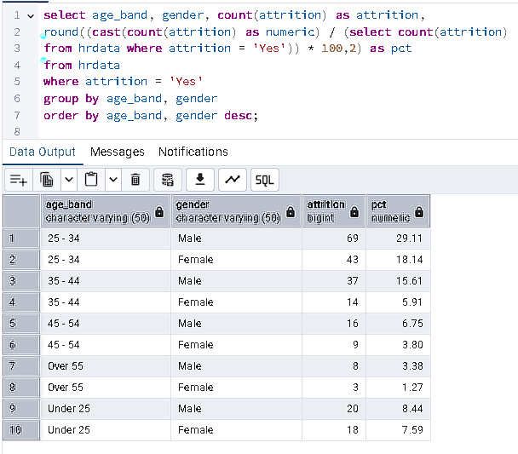
10. Attrition rate by gender for different age group:

Slide 8
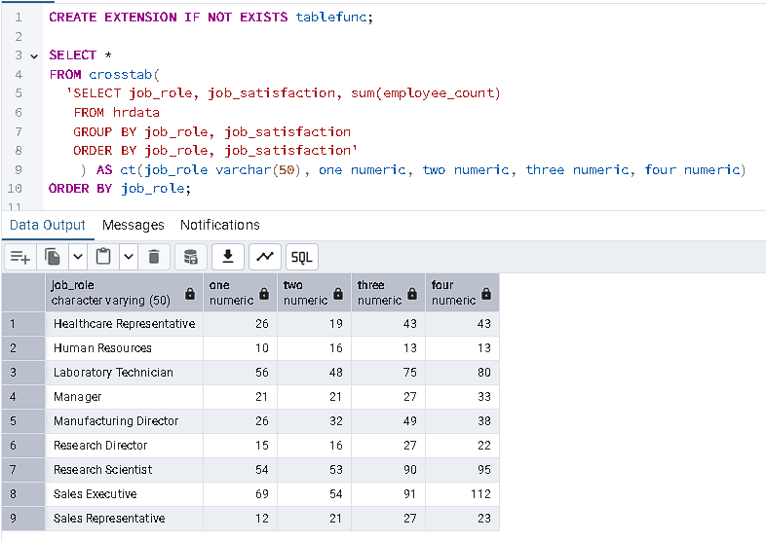
11. Job satisfaction rating:

